Slide 1
Rice Varieties Identification using Deep Learning

Slide 2
ABSTRACT
Rice is one of the most widely consumed staple foods across the globe, especially in Asian countries. Accurate identification of rice varieties is essential for improving quality control, seed selection, supply chain management, and ensuring food authenticity. Traditional methods of rice classification, often relying on manual observation, are time-consuming, error-prone, and inefficient for large-scale applications. To address these challenges, this project titled "Rice Varieties Identification using Deep Learning" proposes an automated, highly accurate classification system utilizing state-of-the-art deep learning techniques.

Slide 3
The system is developed using Python for backend logic, with a user-friendly web interface built using HTML, CSS, and JavaScript, and deployed using the Flask web framework. Two powerful convolutional neural network models, DenseNet-121 and MobileNet, are implemented and evaluated. The DenseNet-121 model achieved a training accuracy of 99.0% and a test accuracy of 99.3%, while the lightweight MobileNet model outperformed with a training accuracy of 99.4% and a test accuracy of 99.5%, making it an ideal candidate for real-time, resource-efficient applications.

Slide 4
The dataset used consists of 60,000 rice grain images, equally distributed across five classes: Arborio, Basmati, Ipsala, Jasmine, and Karacadag, with 12,000 images per class for training. The data preparation phase involved systematic steps including defining data directories, setting uniform image dimensions, image rescaling, structured loading, and preprocessing, ensuring high model generalization and accuracy.

Slide 5
The results demonstrate that the proposed deep learning-based system can reliably distinguish between closely related rice varieties with high precision. The project not only contributes to agricultural digitalization but also paves the way for scalable deployment in food quality assurance, automated grain sorting, and supply chain monitoring applications.

Slide 6
EXISTING SYSTEM
The existing system of Rice Variety Identification focuses on accurately classifying rice grain varieties using an advanced deep learning architecture. In this system, the authors introduce a hybrid model called DENS-INCEP, which effectively combines DenseNet-201 as the primary feature extractor with the Inception module for capturing multi-scale shape-related features of rice grains.
The workflow of the existing system begins with the acquisition of rice grain images, followed by preprocessing steps such as grayscale conversion, binary thresholding, image correction, and edge detection. The dataset used in the base paper includes images of five rice varieties: Arborio, Basmati, Ipsala, Jasmine, and Karacadag.. The data is processed and fed into the DENS-INCEP architecture for training and classification.

Slide 7
DenseNet-201, known for its dense connectivity and efficient feature reuse, serves as a robust backbone in the model, while the Inception module enhances feature extraction by analyzing spatial features at multiple scales. The architecture is trained and validated using the TensorFlow and Keras frameworks, achieving a high overall classification accuracy of 99.94%. Performance is further validated using standard metrics such as accuracy, sensitivity, specificity, confusion matrix, and ROC curves.
The system is designed to contribute to real-world applications in rice grain quality inspection and classification, supporting sustainable agriculture and food traceability. Its architecture is optimized for high accuracy and efficient training, showcasing the potential of transfer learning in agricultural image classification tasks

Slide 8
DISADVANTAGES OF EXISTING SYSTEM
High Computational Complexity: The combination of DenseNet-201 and the Inception module results in a deep and complex model architecture. This demands significant computational resources, both in terms of memory and processing power, making it less suitable for deployment on low-end or edge devices such as mobile phones or embedded systems.
Large Model Size: Due to the extensive number of layers and parameters in DenseNet-201, the resulting DENS-INCEP model has a relatively large size (~89.5 MB). This increases loading times, requires more storage, and limits its portability, especially in bandwidth-constrained or storage-sensitive environments.
Longer Training and Inference Time: The depth and complexity of the model contribute to longer training durations and slower inference speeds. This can be a drawback in scenarios that demand real-time predictions or frequent model updates.

Slide 9
Limited Focus on Lightweight Deployment: The system is primarily designed for high-performance GPU environments. It lacks optimization for deployment in real-world agricultural fields where compact, efficient, and energy-conserving solutions are often required.
Absence of Real-Time Application Demonstration: The base paper emphasizes model architecture and performance metrics but does not include an interactive or deployable application (e.g., web or mobile-based classifier) for end-user use. This limits its immediate practical applicability in real-world scenarios.
No Visual Interpretability Features: Although the model performs well in classification tasks, it does not integrate any explainability methods such as Grad-CAM, which could help in understanding the model’s focus areas and build user trust in critical use cases.

Slide 10
PROPOSED SYSTEM
The proposed system aims to build an efficient and accurate rice variety classification model by leveraging deep learning techniques using DenseNet-121 and MobileNet architectures. This system is designed to classify five types of rice grains—Arborio, Basmati, Ipsala, Jasmine, and Karacadag—based on their visual characteristics using high-resolution image data.
The backend of the system is developed using Python, with the frontend built using HTML, CSS, and JavaScript, and the entire application is deployed using the Flask web framework. The rice grain images are preprocessed through a series of data preparation steps, which include defining data directories, setting image dimensions, rescaling pixel values, and loading structured datasets. These steps ensure consistent input data for training the models.

Slide 11
The dataset used contains a total of 60,000 images, with each rice variety having 12,000 training images. The images are uniformly resized and normalized before being fed into the deep learning models. Two different CNN-based models are implemented:
DenseNet-121: A moderately deep neural network known for its dense connectivity, used as a feature extractor and classifier.
MobileNet: A lightweight architecture designed for mobile and edge-device applications, optimized for efficiency and speed.

Slide 12
Both models are trained separately, and their performances are evaluated using training and testing datasets. Standard classification metrics such as accuracy, confusion matrix are used for assessing the system’s effectiveness. The entire system is integrated into a web-based interface, allowing users to upload rice grain images and receive immediate classification results.
The architecture of the proposed system is modular, consisting of components for data preprocessing, model training, performance evaluation, and real-time prediction. This modular design supports ease of experimentation, scalability, and future integration of additional functionalities.

Slide 13
ADVANTAGES OF PROPOSED SYSTEM
Lightweight and Efficient Models: By utilizing DenseNet-121 and MobileNet, the system maintains high classification accuracy while significantly reducing model size and computational complexity compared to deeper architectures like DenseNet-201. This makes it highly suitable for environments with limited processing power.
High Accuracy with Reduced Complexity: Despite using more compact models, the system achieves excellent performance—DenseNet-121 records a test accuracy of 99.3%, and MobileNet achieves 99.5%. This demonstrates that complex architectures are not always necessary to achieve top-tier results.

Slide 14
Faster Training and Inference Times: The shallower depth and optimized design of the selected models allow for quicker training cycles and faster prediction times, making the system more practical for real-time applications and frequent updates.
Deployment-Ready for Web and Mobile Platforms: The system is developed using Flask and integrates a user-friendly web interface with HTML, CSS, and JavaScript, enabling smooth deployment on various platforms. The use of MobileNet further supports deployment on mobile and edge devices.

Slide 15
Reduced Resource Requirements: Compared to the base model, the proposed system requires less memory and processing power, making it ideal for use in resource-constrained environments such as agricultural fields, local processing centers, or handheld devices.
Scalability and Flexibility: The modular design of the system allows easy updates, such as adding new rice varieties or retraining with additional datasets. This ensures long-term scalability and adaptability to changing agricultural needs.

Slide 16
Improved Real-World Applicability: With a simple and interactive web-based application, the system becomes more accessible to end-users like farmers, quality inspectors, or distributors who can benefit from fast and accurate rice variety classification.
Supports Real-Time Prediction: The low-latency inference capability of the models makes the system suitable for real-time prediction scenarios, where instant feedback is essential for sorting, packaging, or export quality verification processes.

Slide 17
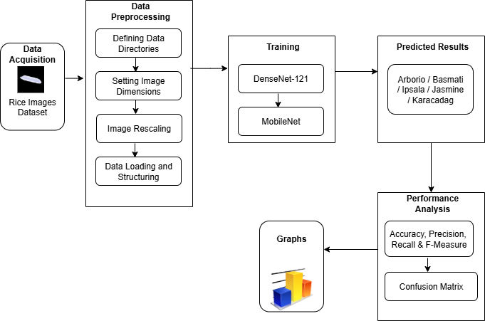
SYSTEM ARCHITECTURE

Slide 18
HARDWARE REQUIREMENTS
System : Pentium i3 Processor.
Hard Disk : 20 GB.
Monitor : 15’’ LED
Input Devices : Keyboard, Mouse
Ram : 8 GB

Slide 19
SOFTWARE REQUIREMENTS
Operating System : Windows 10 / 11.
Coding Language : Python.
Web Framework : Flask.
Frontend : HTML, CSS, JavaScript.

Slide 20
REFERENCE
WAHYUDI AGUSTIONO, KURNIAWAN EKA PERMANA, CAROLINE CHAN, DESHINTA ARROVA DEWI, AND MOCH. MIFTACHUR RIFQI AL HUSAIN, “Rice Variety Identification Based on Transfer Learning Architecture Using DENS-INCEP”, IEEE Access, Volume: 13, 2025.

